Slide 1
Survey Report
Jerry Xie 1012

Slide 2
Q1
Which is the worst things appeared in Maple Leaf that in your opinion?
The hot water pipes are broken.
Your teacher give you a very low mark.
Found buggies in your noodles.
Your teacher token your cellphone for few weeks.

Slide 3
Q1

Slide 4
Q2
Which is the most dangerous things appeared in Maple Leaf that in your opinion?
The walls are fallen.
The desks are broken.
Chemical reaction explodes in the lab.
Your consular is standing back of you and watching you.

Slide 5
Q2

Slide 6
Q3
Do you think Maple Leaf is BETTER than the other public school?
Of Course, YES!!!
NO!!! Absolutely!

Slide 7
Q3

Slide 8
Q4
Can you be living in Maple Leaf happily?
Of Course, YES!!!
NO!!! Absolutely!

Slide 9
Q4

Slide 10
Q5
Please give a degree of how bad of Maple Leaf International School.
NOT SO BAD SO BAD

Slide 11

Q5

Slide 12
Q6
Please give a mark of foods that in Maple Leaf cafeteria.
NOT SO BAD ←⎯⎯⎯⎯→ SO BAD

Slide 13
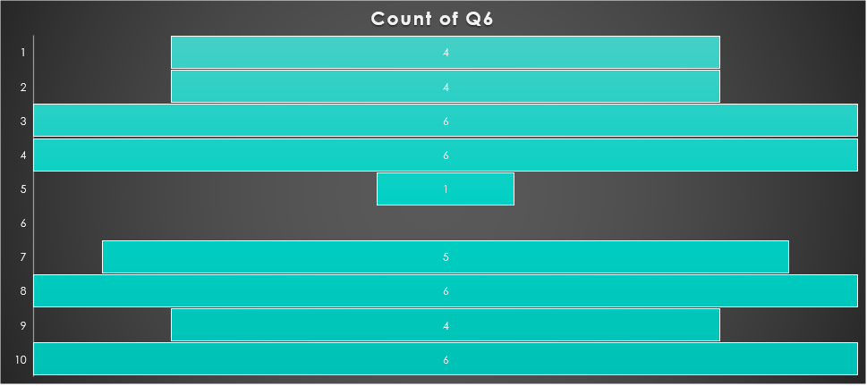
Q6

Slide 14
Q7
Do you think Maple Leaf needs to pay more attention on the basic supplements? Why?

Slide 15
Q7
80%: Broken hot water pipe.

Slide 16
Q8
Who is the worst teacher that you ever met? Why?

Slide 17
Q8
%60 : Miss. Berwick. Too strict.
%20: Their consular. Never felling free.

Slide 18
Thanks for watching!
Jerry xie
1012
IT 10

